Slide 1
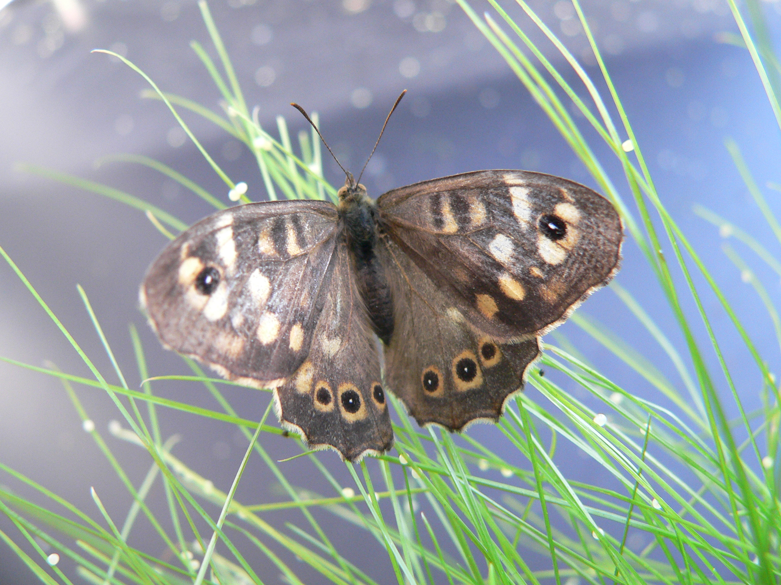
How do humans impact butterfly and moths habitats?
Casper J. Breuker & Melanie Gibbs

Slide 2
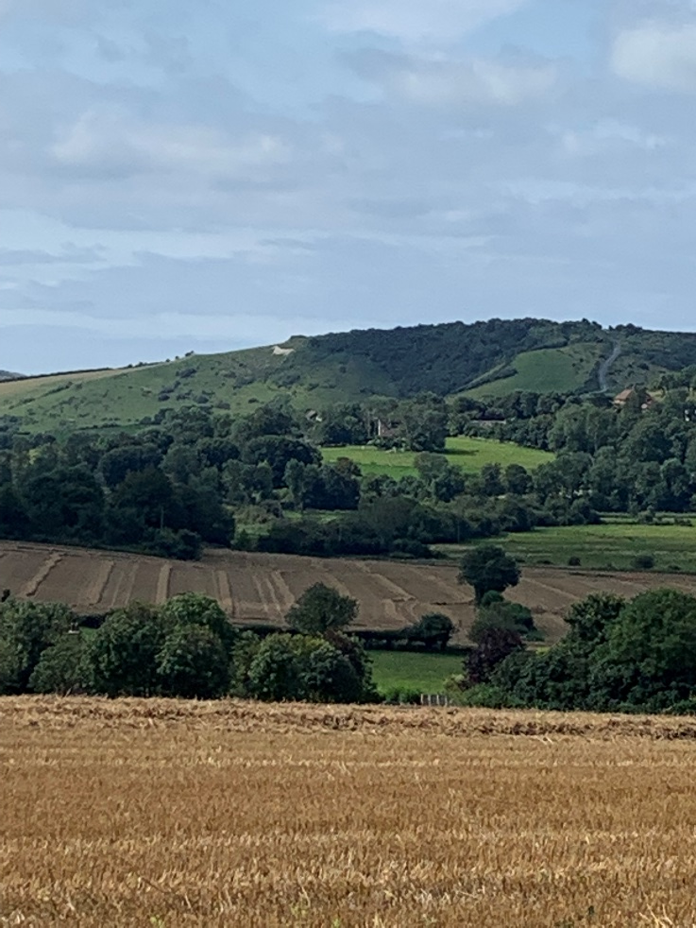
In the UK, butterfly and moth numbers are getting less in many of the habitats in which they live
There are many reasons why, but 3 examples are given below:
1. Their habitats have been destroyed by humans
2. Humans have split-up their habitats into smaller places
3. Humans use insecticides to kill insect pests

Slide 3
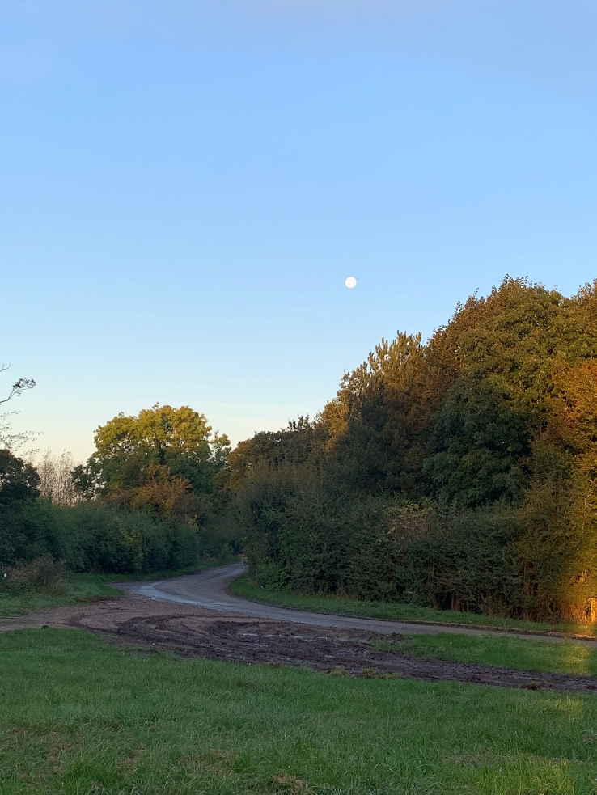
Habitats destroyed
Humans destroy habitats when they change the environment around them to make it nicer or easier for humans to live in:
To build roads, houses and towns
To create more land to farm and make food for humans
To plant trees and/or make parks and play areas

Slide 4
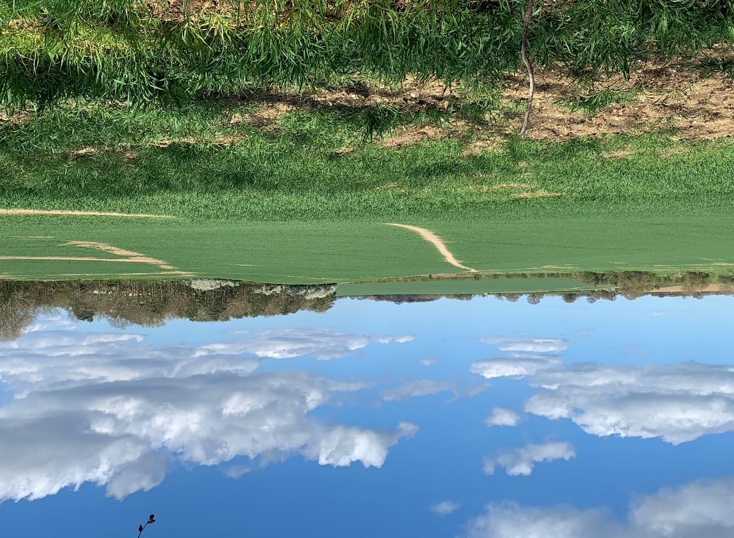
Splitting-up habitats into smaller places
Reduces the amount of space that the animals have to live
Causes food resources to become spread out so that they are very far away or difficult to find
Splitting-up habitats in this way is called habitat fragmentation
Habitat fragmentation can also change the conditions inside the habitat

Slide 5
Using Insecticides
Sometimes, rather than immediately kill the moth or butterfly insecticides can have unwanted side-effects like affecting:
how well the caterpillar grows, or
how well the caterpillar can move to find food, or a safe place to hide from predators.
These unwanted side-effects can cause a drop in the number of moths and butterflies that survive
All images by Melanie Gibbs and Casper Breuker

